Slide 1
Ascaris lumbricoides
Mamita Rai Gurung

Slide 2
Introduction
Also known as roundworm.
Ascaris lumbricoides causes ascariasis.
Infections with these parasites are more common where sanitation is poor and raw human feces are used as fertilizer.
Ascariasis is prevalent worldwide and more in tropical and subtropical countries
More than 2 billion people are affected by this infection

Slide 3
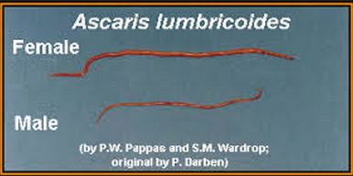
Ascaris lumbricoides is characterized by its great size. The adult worms are cylindrical, with a tapering anterior end. They are the largest of the common nematode parasites of humans. Males are 2–4 mm in diameter and 15–31 cm long. The males' posterior end is curved ventrally and has a bluntly pointed tail. Females are 3–6 mm wide and 20–49 cm long.

Slide 4
Transmission and life cycle
Humans are infected by eating eggs contaminated within human faeces.
In small intestine(duodenom) of human, eggs hatch to liberate larva( (called rhabditiform larva) . These larva migrates from gut wall into the blood stream and then to lungs.
From lungs, these larva are coughed off, swollowed and thus returned to small intestine where they mature to form adult male and female.
The worms then mature and mate in the intestine, with the production of eggs which are passed in the stool. The entire developmental process from egg ingestion to egg passage from the adult female takes from 8 to 12 weeks. During her life span, egg deposition may reach a total of 27,000,000 eggs.

Slide 5
Both unfertilized and fertilized eggs are passed.
Fertilized eggs will become infective within 2 weeks if they are in moist, warm soil where they may remain viable for months or even years. The fertilized (75 µm x 50 µm) egg is broadly oval, with a thick, mammilated coat, usually bile-stained. Unfertilized eggs are usually more oval, measure up to 90 µm long, have extremely minimal mammilated layer.
Often both types of eggs are found in the same stool specimen. The total absence of fertilized eggs means only female worms are present in the intestine.

Slide 6
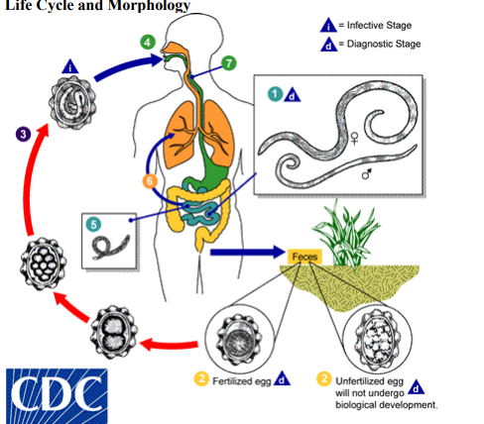

Slide 7
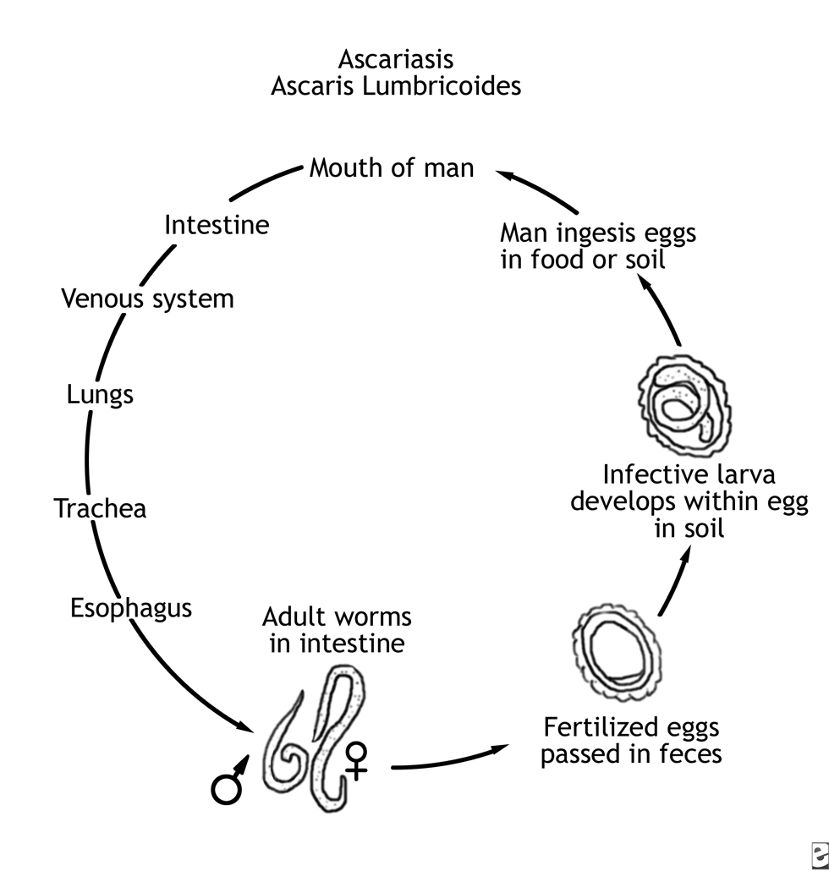

Slide 8
Pathogenesis
Pathogenesis caused by Ascaris infections is attributed to
The host's immune response,
Effects of larval migration,
Mechanical effects of the adult worms, and
Nutritional deficiencies due to the presence of the adult worms.
The major damages occur during the larval migration rather than from the presence of adult worm in the intestine. The principle sites of tissues reaction are the lungs where the inflammation may occur in lungs with eosinophilic exudates occurs in response to larval antigen, creating transient pulmonary infiltrates, called Loeffler's syndrome.

Slide 9
Clinical manifestation
Often, asymptomatic.
However, in the case of a particularly bad infection, symptoms may include bloody sputum, cough, fever, abdominal discomfort, passing worms, etc
Ascaris pneumonia with fever, cough and eosinophilia can occur with a heavy larval burden.
Abdominal pain and even obstruction can occur due to presence worms in intestine.
Due to heavy burden of ascaris worm, malnutrition may occur in childrens of developing countries.

Slide 10
Lab diagnosis:
In the larval migration- diagnosis can be made by finding the larvae in sputum or in gastric washings.
During the intestinal phase, the diagnosis can be made by finding the eggs (unfertilized or fertilized) or adult worms in the stool.
- microscopic detection of eggs, eggs are most easily seen on a direct wet smear or a wet preparation of the concentration sediment in stool by wet mount.

Slide 11
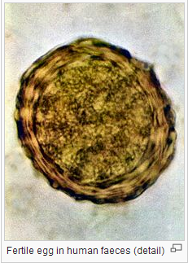
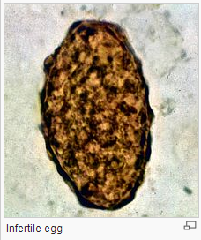

Slide 12
Treatement:
- Mebendazole, Pyrantel pamoate
Prevention and control:
- Proper disposal of faeces, hygine and avoidance of use of faeces as fertilizers

